Slide 1

Cloud Storage Technologies: Object, Block, and File Storage Compared
Presented By:
Name : Karnesh V K
Reg No: 192524296
Guided By:
DR.Latha

Slide 2


Introduction
Cloud storage is used to store and access data through the internet.
It provides scalable and flexible data storage.
There are three main types:
  Object Storage
  Block Storage
  File Storage
Each type has a different storage architecture.
The choice depends on data type, performance, and usage requirements.

Slide 3
Objective:
To understand the three main types of cloud storage.
To compare Object, Block, and File Storage.
To study their different storage architectures.
To identify suitable use cases for each storage type.
To understand their importance in cloud-based applications.

Slide 4
Core Technical Explanation
Three Types of Cloud Storage
Object Storage
Stores data as objects.
Best for large and unstructured data.
Example: Images, videos, backups.
Block Storage
Divides data into fixed-size blocks.
Provides high performance.
Best for databases and virtual machines.
File Storage
Stores data as files and folders.
Easy to share and manage.
Best for shared documents and applications.

Slide 5
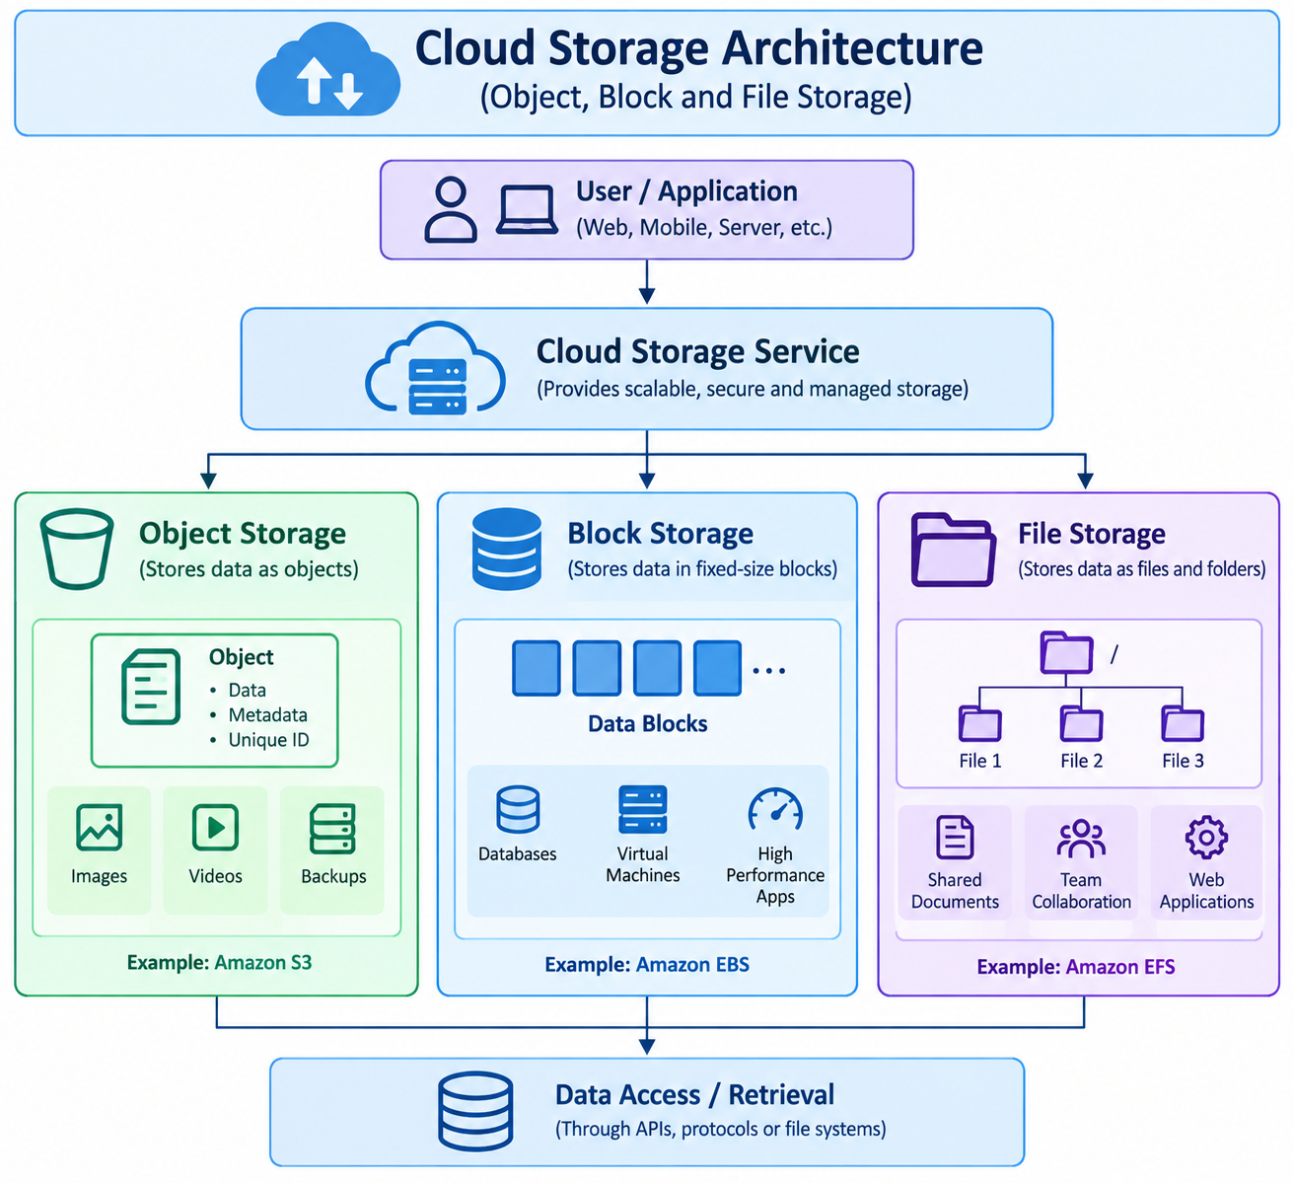
Architecture Diagram
User/Application sends or requests data.
Cloud Storage Service manages the stored data.
Object Storage stores data as objects.
Block Storage stores data in fixed-size blocks.
File Storage stores data as files and folders.

Slide 6
Real-World Use Case
Industry Applications
Object Storage:
Netflix/media platforms → Videos and media files
Companies → Backup and data archives
Block Storage:
Banks → Databases
Cloud applications → Virtual machines
File Storage:
Colleges/offices → Shared documents
Organizations → Team file sharing
Industry Pattern:
Object → Big Data & Media
Block → Databases & High Performance
File → Shared Data & Collaboration

Slide 7
Conclusion
Object, Block, and File Storage have different architectures and purposes.
Object Storage is suitable for large and unstructured data.
Block Storage provides high performance for databases and applications.
File Storage is useful for shared files and collaborative applications.

